Slide 1
Builder Design Pattern
Under Creational design pattern

Slide 2
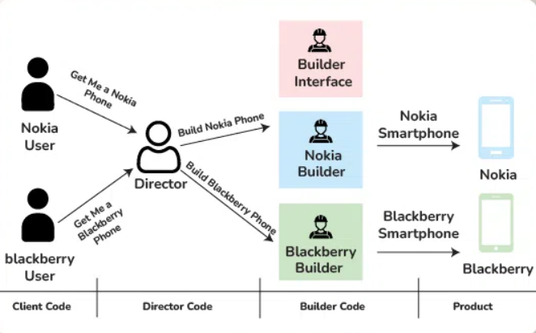
The Builder pattern is a creational design pattern that separates the construction of a complex object from its representation. It allows you to construct different representations of an object using the same construction process. This pattern is useful when you need to create complex objects with many optional parts or configurations, and you want to keep the construction process flexible and easy to understand.

Slide 3
In simpler terms, think of the Builder pattern as a way to build complex objects step by step. Instead of creating the object directly with a single constructor, you use a Builder class to specify each part of the object separately. This makes it easier to create different variations of the object with different configurations.

Slide 4
Advantages
Separation of concerns: Builder separates object construction from its representation, promoting cleaner code organization.
Flexible construction: Builders offer fine-grained control over object creation, enabling customization and variation.
Encapsulation: Construction logic is encapsulated within the builder, hiding details from client code for easier use.
Immutable objects: Builders support the creation of immutable objects by enforcing field initialization during construction.
Reusability: Builders can be reused to construct multiple objects with different configurations, reducing code duplication.
Readability and maintainability: Builder methods provide descriptive property setting, enhancing code readability and isolating construction logic for easier maintenance

